Slide 1
Set Theory

Slide 2
Set
A well defined collection of distinct objects is called a set.
The objects are called the elements or members of the set.
Sets are denoted by capital letters A, B, C …, X, Y, Z.
The elements of a set are represented by lower case letters a, b, c, … , x, y, z.
If an object x is a member of a set A, we write x ∈ A , which
reads “x belongs to A” or “x is in A” or “x is an element of A”, otherwise we write x ∉ A , which reads “x does not belong to A” or
“x is not in A” or “x is not an element of A”.

Slide 3
TABULAR FORM
We list all the elements of a set, separated by commas and enclosed within braces or curly brackets{}.
EXAMPLES
In the following examples we write the sets in Tabular Form.
A = {1, 2, 3, 4, 5} is the set of first five Natural Numbers.
B = {2, 4, 6, 8, …, 50} is the set of Even numbers up to 50.
C = {1, 3, 5, 7, 9, …} is the set of positive odd numbers.

Slide 4
DESCRIPTIVE FORM:
We state the elements of a set in words.
EXAMPLES
Now we will write the above examples in the Descriptive Form.
A = set of first five Natural Numbers. ( Descriptive Form )
B = set of positive even integers less or equal to fifty. ( Descriptive Form )
C = set of positive odd integers. ( Descriptive Form )

Slide 5
SET BUILDER FORM:
We write the common characteristics in symbolic form, shared by all the elements of the set.

Slide 6
EXAMPLES:
Now we will write the same examples which we write in Tabular as well as Descriptive Form ,in Set Builder Form .
A = { x ∈N | x ≤ 5} ( Set Builder Form)
B = { x ∈E | 0 < x ≤ 50} ( Set Builder Form)
C = { x ∈O | 0 < x } ( Set Builder Form)

Slide 7
SETS OF NUMBERS:
Set of Natural Numbers N = {1, 2, 3, … }
Set of Whole Numbers W = {0, 1, 2, 3, … }
Set of Integers Z = {…, -3, -2, -1, 0, +1, +2, +3, …} = {0, ±1, ±2, ±3, …}
Set of Even Integers E = {0, ± 2, ± 4, ± 6, …}
Set of Odd Integers O = {± 1, ± 3, ± 5, …}
Set of Prime Numbers P = {2, 3, 5, 7, 11, 13, 17, 19, …}

Slide 8
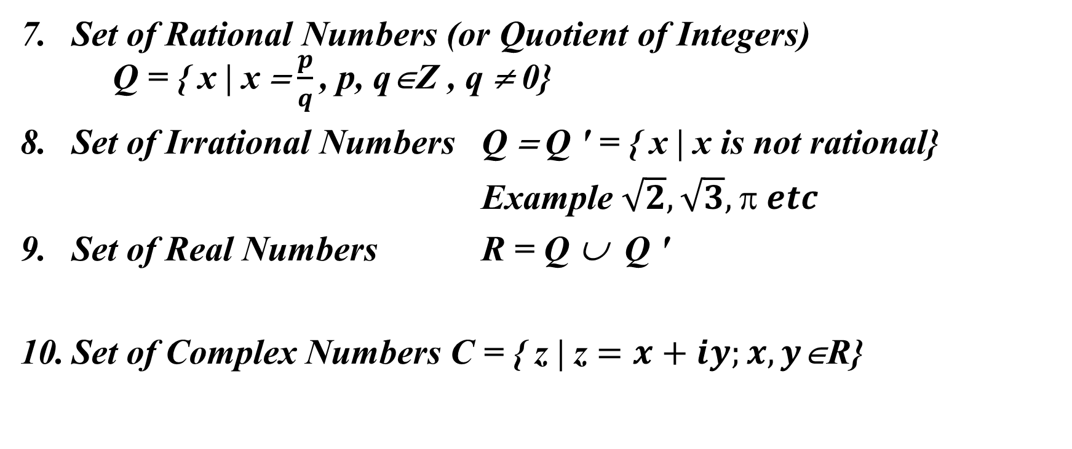
SETS OF NUM…
Set of Rational Numbers (or Quotient of Integers) Q = { x | x = $\frac{p}{q}$ , p, q∈Z , q ≠ 0}
Set of Irrational Numbers Q = Q ' = { x | x is not rational}
Example $\sqrt{2},\sqrt{3}, π etc$
Set of Real Numbers R = Q ∪ Q '
Set of Complex Numbers C = { z | z $=x+iy;x,y$∈R}

Slide 9
SUBSET:
If A & B are two sets, then A is called a subset of B. It is written as A ⊆ B. The set A is subset of B if and only if any element of A is also an element of B.
Symbolically:
A ⊆ B ⇔ if x∈A, then x∈B

Slide 10
REMARK:
When A ⊆ B, then B is called a superset of A.
When A is not subset of B, then there exist at least one x ∈ A such that x ∉B.
Every set is a subset of itself.

Slide 11
EXAMPLES:
Let
A = {1, 3, 5} B = {1, 2, 3, 4, 5}
C = {1, 2, 3, 4} D = {3, 1, 5}
Then
A ⊆ B ( Because every element of A is in B )
C ⊆ B ( Because every element of C is also an element of B )
A ⊆ D ( Because every element of A is also an element of D and also note that every element of D is in A so D ⊆ A )
and A is not subset of C or A ⊄ C
( Because there is an element 5 of A which is not in C )

Slide 12

EXAMPLE:
The set of integers “Z” is a subset of the set of Rational Number
“Q”, since every integer ‘n’ could be written as:
n = $\frac{n}{1}\text{Î} \text{Q}$
Hence Z ⊆ Q.

Slide 13
PROPER SUBSET:
Let A and B be sets. A is a proper subset of B, if and only if, every element of A is in B but there is at least one element of B that is not in A, and is denoted
as A ⊂ B.
EXAMPLE:
Let A = {1, 3, 5} B = {1, 2, 3, 5}
then A ⊂ B ( Because there is an element 2 of B which is not in A).
N ⊂ W ⊂ Z ⊂ Q ⊂ R

Slide 14
EQUAL SETS:
Two sets A and B are equal if and only if every element of A is in B and every element of B is in A and is denoted A = B.
Symbolically:
EXAMPLE:
A = B iff A ⊆ B and B ⊆ A
Let A = {1, 2, 3, 6} B = the set of positive divisors of 6
C = {3, 1, 6, 2} D = {1, 2, 2, 3, 6, 6, 6}
Then A, B, C, and D are all equal sets.

Slide 15
NULL SET:
A set which contains no element is called a null set, or an empty set or a
void set. It is denoted by the Greek letter ∅ (phi) or { }.
EXAMPLE
A = {x | x is a person taller than 10 feet} = ∅
( Because there does not exist any human being which is taller then 10 feet )
B = {x | x² = 4, x is odd} = ∅
(Because we know that there does not exist any odd number whose square is 4)

Slide 16
REMARK
∅ is regarded as a subset of every set.

Slide 17
EXERCISE:
Determine whether each of the following statements is true or false.
x ∈ {x} TRUE
( Because x is the member of the singleton set { x } )
2. {x}⊆ {x} TRUE
( Because Every set is the subset of itself.

Slide 18
Note that every Set has necessarily two subsets ∅ and the Set itself. These two subset are known as Improper subsets and any other subset is called Proper Subset)
{x} ∈{x} FALSE
( Because {x} is not the member of {x} ) Similarly other
{x} ∈{{x}} TRUE
∅ ⊆ {x} TRUE
∅ ∈ {x} FALSE

Slide 19
UNIVERSAL SET:
The set of all elements under consideration is called the Universal Set. The Universal Set is usually denoted by U.
Example
A = { 2, 4, 6 }
B = {1, 3, 5 }
Universal set = U = { 1, 2, 3, 4, 5, 6 }

Slide 20
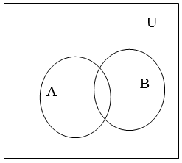
VENN DIAGRAM:
A Venn diagram is a graphical representation of sets by regions in the plane. The Universal Set is represented by the interior of a rectangle, and the other sets are represented by disks lying within the rectangle.

Slide 21
FINITE AND INFINITE SETS:
A set S is said to be finite if it contains exactly m distinct elements where m denotes some non negative integer.
In such case we write |S| = m or n(S) = m
A set is said to be infinite if it is not finite.

Slide 22
EXAMPLES:
The set S of letters of English alphabets is finite and |S| = 26
The null set ∅ has no elements, is finite and |∅| = 0
The set of positive integers {1, 2, 3,…} is infinite.

Slide 23
EXERCISE:
Determine which of the following sets are finite/infinite.
A = {month in the year} FINITE
B = {even integers} INFINITE
C = {positive integers less than 1} FINITE
D = {animals living on the earth} FINITE
E = {lines parallel to x-axis} INFINITE
F = {x ∈R | x¹⁰⁰ + 29x⁵⁰ – 1 = 0} FINITE

Slide 24

MEMBERSHIP TABLE:
A table displaying the membership of elements in sets.
To indicate that an element is in a set, a 1 is used;
To indicate that an element is not in a set, a 0 is used.
Membership tables can be used to prove set identities.

Slide 25
MEMBERSHIP TABLE:
The above table is the Membership table for Complement of A. Now in the above table note that if an element is the member of A, then it cannot be the Member of A^{c} thus where in the table we have 1 for A in that row we have 0 in A^{c}.
Similarly, if an element is not a member of A, it will be the member of A^{c}. So we have 0 for A and 1 for A^{c}.

Slide 26
UNION:
Let A and B be subsets of a universal set U. The union of sets A and B is the set of all elements in U that belong to A or to B or to both, and is denoted A ∪ B.
Symbolically:
A ∪ B = {x ∈U | x ∈A or x ∈ B}

Slide 27
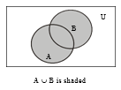
EMAMPLE:
Let U = {a, b, c, d, e, f, g}
A = {a, c, e, g}, B = {d, e, f, g} Then
A ∪ B = {x ∈U | x ∈A or x ∈ B}
={a, c, d, e, f, g}
VENN DIAGRAM FOR UNION:

Slide 28
REMARK:
A ∪ B = B ∪ A that is union is commutative you can prove this very easily only by using definition.
A ⊆ A ∪ B and B ⊆ A ∪ B
The above remark of subset is easily seen by the definition of union.

Slide 29
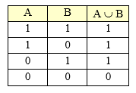
MEMBERSHIP TABLE FOR UNION:
REMARK:
This membership table is similar to the truth table for logical connective, disjunction (∨).

Slide 30
INTERSECTION:
Let A and B subsets of a universal set U. The intersection of sets A and B is the set of all elements in U that belong to both A and B and is denoted A ∩ B.
Symbolically:
A ∩ B = {x ∈U | x ∈ A and x ∈B}

Slide 31
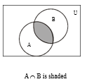
EXMAPLE:
Let U = {a, b, c, d, e, f, g}
A = {a, c, e, g}, B = {d, e, f, g}
Then A ∩ B = {e, g}
VENN DIAGRAM FOR INTERSECTION:

Slide 32
REMARK:
A ∩ B = B ∩ A
A ∩ B ⊆ A and A ∩ B ⊆ B
If A ∩ B = φ, then A & B are called disjoint sets.

Slide 33
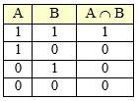
MEMBERSHIP TABLE FOR INTERSECTION:
REMARK:
This membership table is similar to the truth table for logical connective, conjunction (∧).

Slide 34
DIFFERENCE:
Let A and B be subsets of a universal set U. The difference of “A and B” (or relative complement of B in A) is the set of all elements in U that belong to A but not to B, and is denoted A – B or A \ B.
Symbolically:
A – B = {x ∈U | x ∈ A and x∉B}

Slide 35
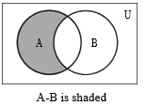
EXAMPLE:
Let U = {a, b, c, d, e, f, g}
A = {a, c, e, g}, B = {d, e, f, g}
Then A – B = {a, c}
VENN DIAGRAM FOR SET DIFFERENCE:

Slide 36
REMARK:
A – B ≠ B – A that is Set difference is not commutative.
A – B ⊆ A
A – B, A ∩ B and B – A are mutually disjoint sets.

Slide 37
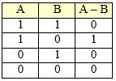
MEMBERSHIP TABLE FOR SET DIFFERENCE:
REMARK:
The membership table is similar to the truth table for ~ (p →q).

Slide 38

COMPLEMENT:
Let A be a subset of universal set U. The complement of A is the set of all element in U that do not belong to A, and is denoted A′, $\overline{A}$ or A^{c} Symbolically:
A^{c} = {x ∈U | x ∉A}

Slide 39
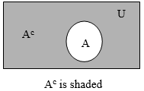
EXAMPLE:
Let U = {a, b, c, d, e, f, g] A = {a, c, e, g}
Then A^{c} = {b, d, f}
VENN DIAGRAM FOR COMPLEMENT:
REMARK :
A^{c} = U – A
A ∩ A^{c} = φ
A ∪ A^{c} = U

Slide 40

MEMBERSHIP TABLE FOR COMPLEMENT:
REMARK
This membership table is similar to the truth table for logical connective
negation (~)

Slide 41
EXERCISE:
Let U = {1, 2, 3, …, 10}, X = {1, 2, 3, 4, 5}
Y = {y | y = 2 x, x ∈X}, Z = {z | z² – 9z + 14 = 0}
Enumerate:
(1)X ∩ Y (2) Y ∪ Z (3) X – Z
(4)Y^{c} (5) X^{c} – Z^{c} (6) (X – Z) ^{c}
Firstly we enumerate the given sets. Given
U = {1, 2, 3, …, 10},
X = {1, 2, 3, 4, 5}
Y = {y | y = 2 x, x ∈X} = {2, 4, 6, 8, 10}
Z = {z | z² – 9 z + 14 = 0} = {2, 7}

Slide 42
EXERCISE:
(1) X ∩ Y = {1, 2, 3, 4, 5} ∩ {2, 4, 6, 8, 10}
= {2, 4}
(2) Y ∪ Z = {2, 4, 6, 8, 10} ∪ {2, 7}
= {2, 4, 6, 7, 8, 10}
(3) X – Z = {1, 2, 3, 4, 5} – {2, 7}
= {1, 3, 4, 5}
(4) Y^{c} = U – Y = {1, 2, 3, …, 10} – {2, 4, 6, 8, 10}
= {1, 3, 5, 7, 9}

Slide 43
EXERCISE:
(5) X^{c} = {6, 7, 8, 9, 10}
Z^{c} = {1, 3, 4, 5, 6, 8, 9, 10}
X^{c} – Z^{c} = {6, 7, 8, 9, 10} – {1, 3, 4, 5, 6, 8, 9, 10}
= {7}
(6) (X – Z)^{c} = U – (X – Z)
= {1, 2, 3, …, 10} – {1, 3, 4, 5}
= {2, 6, 7, 8, 9, 10}
NOTE (X – Z)^{c} ≠ X^{c} - Z^{c}

Slide 44
EXERCISE:
Given the following universal set U and its two subsets P and Q, where
U = {x | x ∈ Z,0 ≤ x ≤ 10}
P = {x | x is a prime number}
Q = {x | x² < 70}
Draw a Venn diagram for the above
List the elements in P^{c} ∩ Q

Slide 45
SOLUTION:
First we write the sets in Tabular form.
U = {x | x ∈Z, 0 ≤ x ≤ 10}
Since it is the set of integers that are greater then or equal 0 and less or equal to 10
So we have
U= {0, 1, 2, 3, …, 10}
P = {x | x is a prime number}

Slide 46
SOL…
It is the set of prime numbers between 0 and 10. Remember Prime numbers are those numbers which have only two distinct divisors.
P = {2, 3, 5, 7}
Q = {x | x² < 70}
The set Q contains the elements between 0 and 10 which have their square less or equal to 70.
Q= {0, 1, 2, 3, 4, 5, 6, 7, 8}
Thus we write the sets in Tabular form.

Slide 47
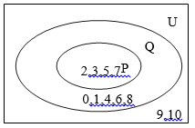
VENN DIAGRAM:
Draw a Venn diagram for the above

Slide 48
P^{c} ∩ Q = ?
P^{c} = U – P = {0, 1, 2, 3, …, 10}- {2, 3, 5, 7}
= {0, 1, 4, 6, 8, 9, 10}
and
P^{c} ∩ Q = {0, 1, 4, 6, 8, 9, 10} ∩ {0, 1, 2, 3, 4, 5, 6, 7, 8}
= {0, 1, 4, 6, 8}

Slide 49
EXERCISE:
Let
U = {1, 2, 3, 4, 5}, C = {1, 3}
and A and B are non empty sets. Find A in each of the following:
A ∪ B = U, A ∩ B = φ and B = {1}
A ⊂ B and A ∪ B = {4, 5}
A ∩ B = {3}, A ∪ B = {2, 3, 4} and B ∪ C = {1,2,3}

Slide 50
EXERCISE:
A ∪ B = U, A ∩ B = φ and B = {1}
SOLUTION:
Since A ∪ B = U = {1, 2, 3, 4, 5}
and A ∩ B = φ,
Therefore A = B^{c} = {1}^{c} = {2, 3, 4, 5}

Slide 51
EXERCISE:
A ⊂ B and A ∪ B = {4, 5} also C = {1, 3}
SOLUTION:
When A ⊂ B, then A ∪ B = B = {4, 5}
Also A being a proper subset of B implies
A = {4} or A = {5}

Slide 52
EXERCISE:
A ∩ B = {3}, A ∪ B = {2, 3, 4}and B ∪ C = {1,2,3} Also C = {1, 3}
SOLUTION:
Since we have 3 in the intersection of A and B as well as in C so we place 3 in common part shared by the three sets in the Venn diagram.
Now since 1 is in the union of B and C it means that 1 may be in C or may be in B, but 1cannot be in B because if 1 is in the B then it must be in A ∪ B but 1 is not there, thus we place 1 in the part of C which is not shared by any other set.
Same is the reason for 4 and we place it in the set which is not shared by any other set.
Now 2 will be in B, 2 cannot be in A because A ∩ B = {3}, and is not in C. So A = {3, 4} and B = {2, 3}

Slide 53
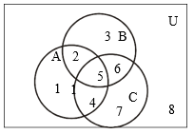
EXERCISE:
Use a Venn diagram to represent the following:
(A ∩ B) ∩ C^{c}
A^{c} ∪ (B ∪ C)
(A – B) ∩ C
(A ∩ B^{c}) ∪ C^{c}

Slide 54
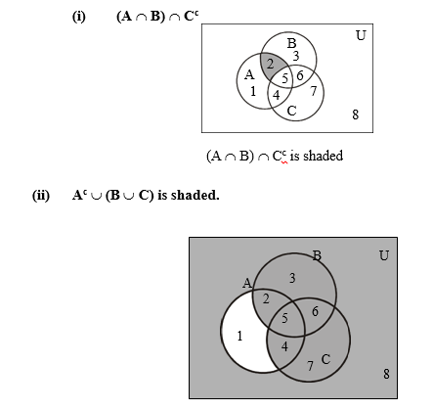
SOLUTION:

Slide 55
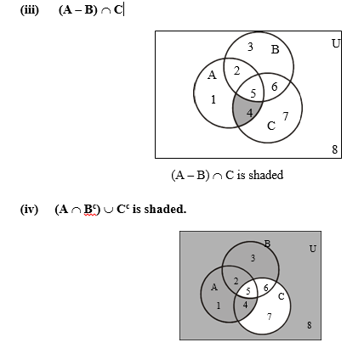
SOLUTION:

Slide 56
PROVING SET IDENTITIES BY VENN DIAGRAMS:
Prove the following using Venn Diagrams:
A – (A – B) = A ∩ B
(A ∩ B)^{c} = A ^{c} ∪ B ^{c}
A – B = A ∩ B ^{c}

Slide 57
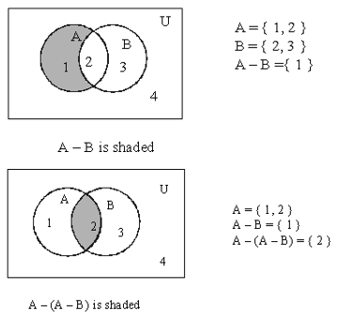
SOLUTION (i)
A - (A – B) = A ∩ B
L.H.S= A - (A – B)

Slide 58
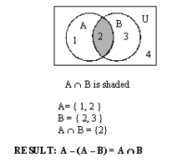
SOLUTION (i)
R.H.S=A ∩ B

Slide 59
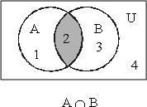
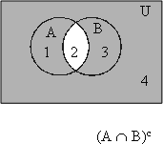
SOLUTION (ii)
(A ∩ B)^{c} = A ^{c} ∪ B ^{c}
^{L.H.S=} (A ∩ B)^{c}

Slide 60
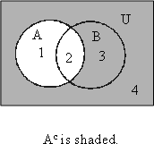
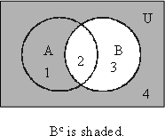
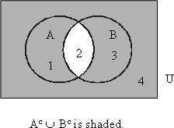
SOLUTION (ii)
R.H.S =A ^{c} ∪ B ^{c}
Hence proved that L.H.S=R.H.S
RESULT: (A ∩ B)^{c} = A ^{c} ∪ B ^{c}

Slide 61
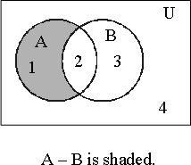
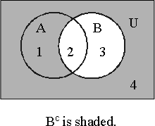
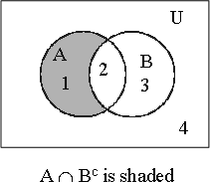
SOLUTION (iii)
A – B = A ∩ B^{c}
Hence proved

Slide 62
PROVING SET IDENTITIES BY MEMBERSHIP TABLE:
Prove the following using Membership Table:
A – (A – B) = A ∩ B
(A ∩ B)^{c} = A ^{c} ∪ B ^{c}
A – B = A ∩ B ^{c}

Slide 63
SOLUTION (i)
A | B | A-B | A-(A-B) | A ∩ B
1 | 1 | 0 | 1 | 1
1 | 0 | 1 | 0 | 0
0 | 1 | 0 | 0 | 0
0 | 0 | 0 | 0 | 0
A – (A – B) = A ∩ B
Since the last two columns of the above table are same hence the corresponding set expressions are same.
That is A – (A – B) = A ∩ B

Slide 64
SOLUTION (ii)
A | B | (A ∩ B) | (A ∩ B)^{c} | A ^{c} | B ^{c} | A ^{c} ∪ B ^{c}
1 | 1 | 1 | 0 | 0 | 0 | 0
1 | 0 | 0 | 1 | 0 | 1 | 1
0 | 1 | 0 | 1 | 1 | 0 | 1
0 | 0 | 0 | 1 | 1 | 1 | 1
(A ∩ B)^{c} = A ^{c} ∪ B ^{c}
Since the fourth and last columns of the above table are same hence the corresponding set expressions are same. That is
(A ∩ B)^{c} = A ^{c} ∪ B ^{c}

Slide 65
SOLUTION (iii)
A – B = A ∩ B ^{c}
A | B | A – B | B ^{c} | A ∩ B ^{c}
1 | 1 | 0 | 0 | 0
1 | 0 | 1 | 1 | 1
0 | 1 | 0 | 0 | 0
0 | 0 | 0 | 1 | 0

